Slide 1


Presentation 2023
Datathon

Slide 2


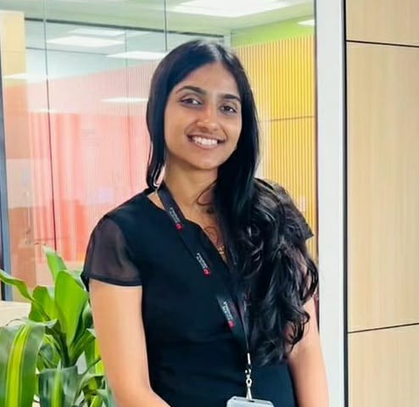
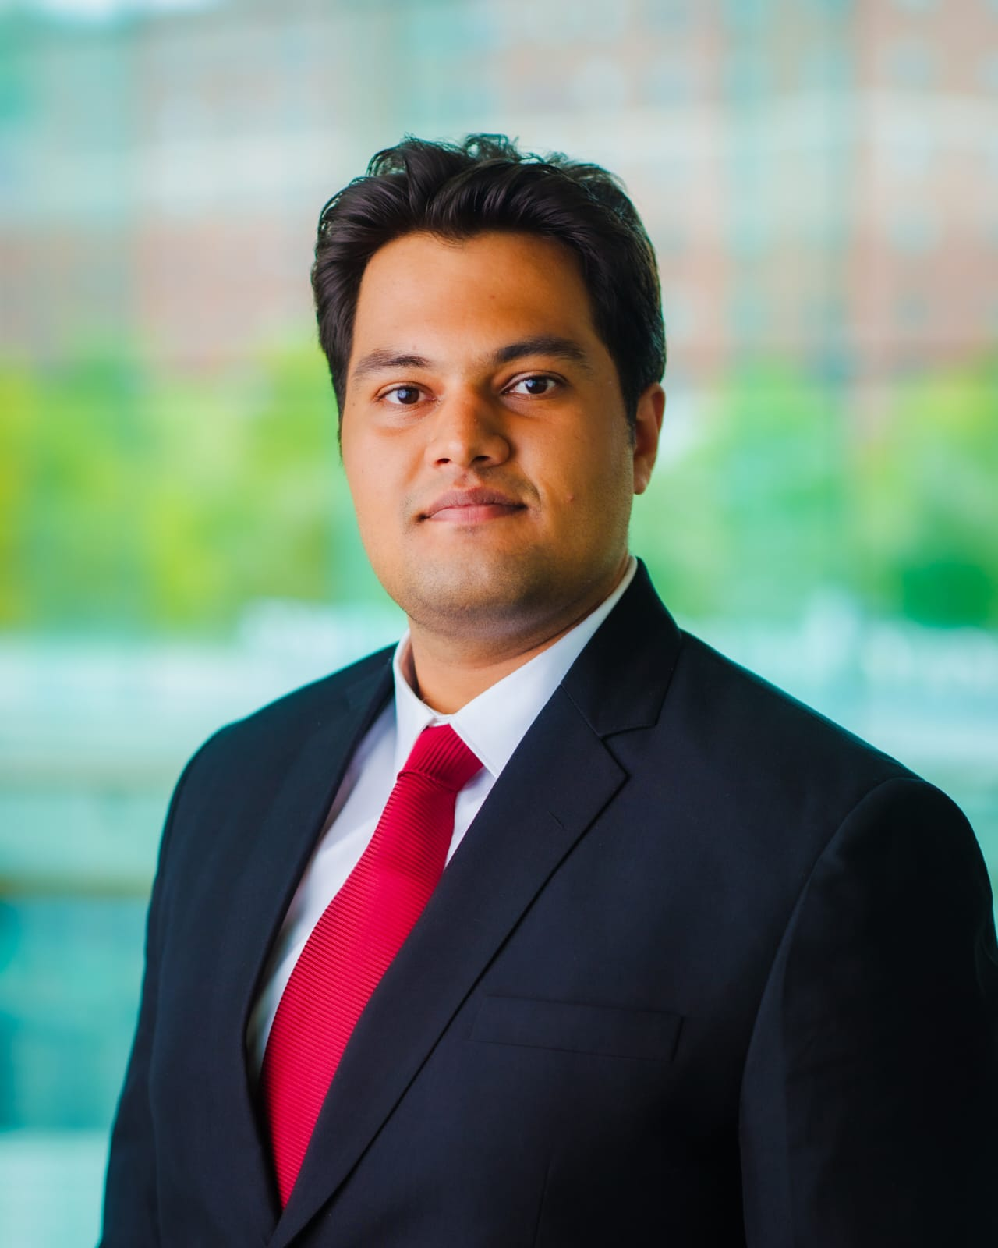
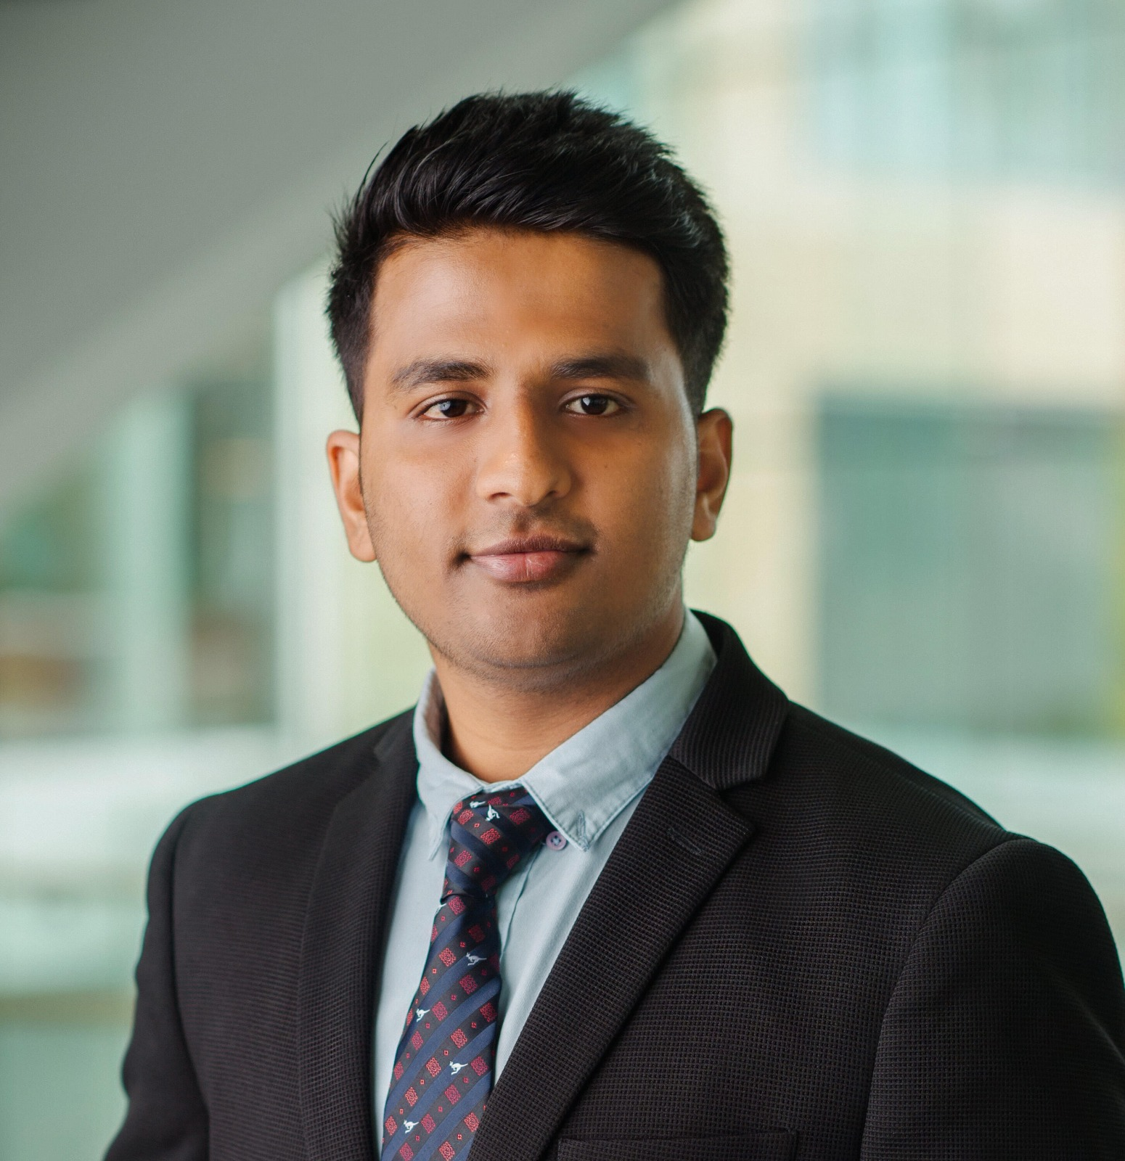



Team - DataWiz
Kanishka Soni
Morgan Maxwell
Sherine George
Shashank
Parag
Mudit
Manager

Slide 3

Content
01
Problem Introduction
02
Solution Statement
03
Design & Implementation
04
Challenges
05
Future Scope
07

Slide 4





Overview
01
Cooperates the massive number of text data, learns the specific patterns and grammar from this data set during the period of training.
Heatwaves Monitoring System
Many heavily populated low- and middle-income countries lack effective Heat Health Warning Systems.
02
03
This reliance on inadequate high-temperature forecasts endangers vulnerable populations during extreme heat events.
Utilize data mining and machine learning to complete an Inventory, enabling data visualization to address these gaps and statistics and enhance heatwave protection for vulnerable populations.
04

Slide 5


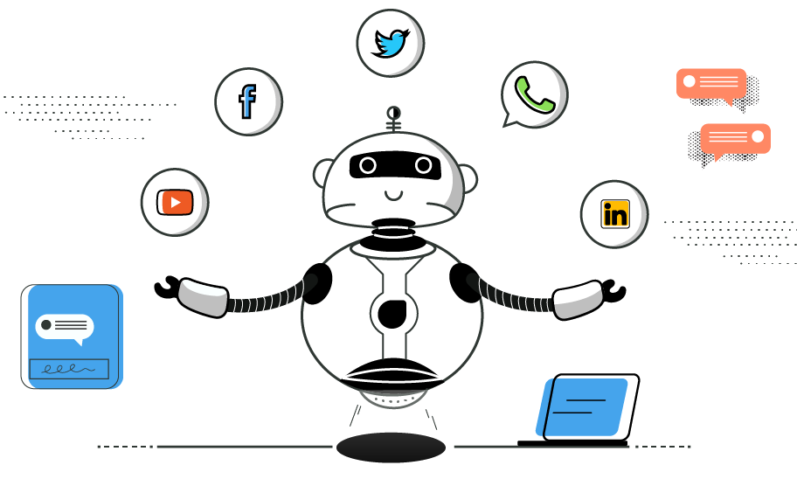


Solution
Key Features:
A UI where you can filter by country and see whether there is a heatwave or not at real time
An efficient mechanism to summarise and extract heat wave related data from research papers
Benefits:
Not having too many sources to rely on
Fast and easy access to information

Slide 6




Design and Implementation
Requirements:
BeatifulSoup, Selenium for Web Scraping
Streamlit for Visualization
NLP to understand and summarise text on heatwaves from research papers
Web Scrape the data from the WMO website
Using WebScraping and NLP to collate heatwaves data from research articles
Store the data in the database
Store the data in the database
Display the results in the streamlit UI
Display the results in the streamlit UI
Scraping from WMO
Scraping from Research articles

Slide 7




Challenges
Multiple Platforms
Low Accuracy and Flexibility
Real Time Information
WMO, Research Papers
Insufficient data and time, insensitive to different word choice and languages
Delay in collecting and updating new data
Notes:
We are currently facing several key challenges in our project. First, integrating data from multiple platforms, such as Canvas, the Tepper website, handshake, and 12Twenty, is proving to be a complex task that requires a significant amount of coding effort. Second, during the initial phase, we have encountered issues with lower accuracy and flexibility, which we are actively working to improve. To create an effective chatbot that consolidates information and enhances efficiency, we also need to pay close attention to language sensitivity. Lastly, there are delays in obtaining real-time information, particularly related to career-related data. This delay could potentially lead to students missing out on valuable opportunities.

Slide 8

Monitor
Future Scope
Deploy
Potential opportunities, advancements, and possibilities
Enhance
Notes:
In terms of our project's future direction, our immediate goal is to tailor this Helpbot to serve Tepper MSBA students as a one-stop resource. As it evolves and becomes more advanced, our vision is to expand its capabilities to cater to both graduate and undergraduate students, recognizing the overlap in information needs. Looking further ahead, our ultimate objective is to develop it into a CMU-wide HelpBot.

Slide 9
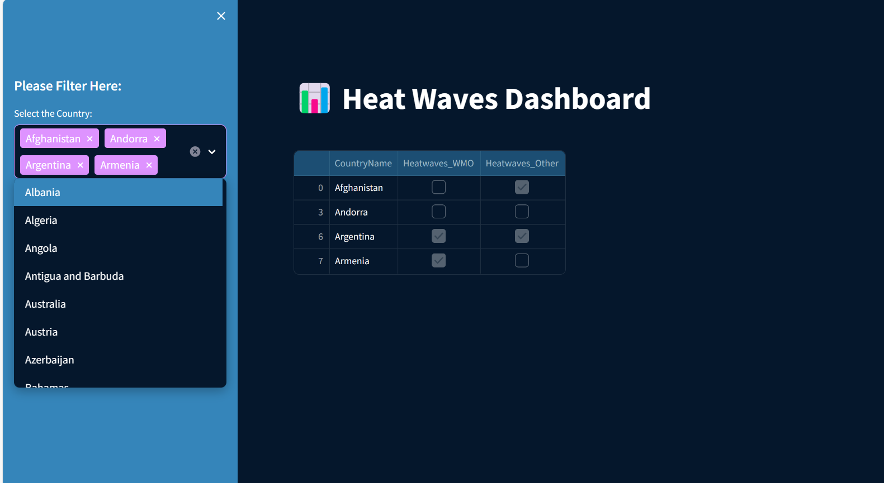
Dashboard - Output
Notes:
In terms of our project's future direction, our immediate goal is to tailor this Helpbot to serve Tepper MSBA students as a one-stop resource. As it evolves and becomes more advanced, our vision is to expand its capabilities to cater to both graduate and undergraduate students, recognizing the overlap in information needs. Looking further ahead, our ultimate objective is to develop it into a CMU-wide HelpBot.

Slide 10
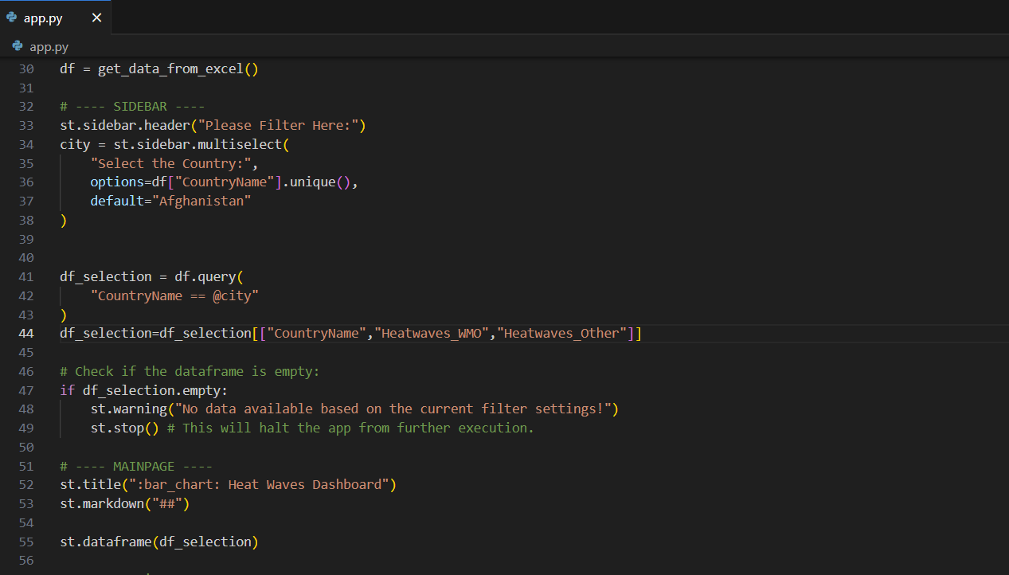
Streamlit Frontend
Notes:
In terms of our project's future direction, our immediate goal is to tailor this Helpbot to serve Tepper MSBA students as a one-stop resource. As it evolves and becomes more advanced, our vision is to expand its capabilities to cater to both graduate and undergraduate students, recognizing the overlap in information needs. Looking further ahead, our ultimate objective is to develop it into a CMU-wide HelpBot.

Slide 11

THANK YOU

